Slide 1
KARNATAK UNIVERSITY, DHARWAD
Department of computer science
Presentation on
PETS CORNER APP USING ANDROID
Guided By:
MR. VIJAYKUMAR G
-Life is better with pets

Slide 2
TABLE OF CONTENTS
Introduction
Existing System
Proposed System
Objectives
System flowchart
ER diagram
Data flow diagram
Modules/Implementation
System Requirements
Screenshots
Limitations/Future scope

Slide 3
INTRODUCTION
We are now living the computer age. Now the computer is controlling all the important tasks in our routine life. Android devices are also versatile because they are indispensable in the present day. To do some specific tasks, Android needs applications. Thus, to create an Android application, I took up a project named “Pets Corner”. To use this applications, all of its users will have a valid user id and password associated with it.
A user will be able to enter the pet’s details, including its price, breed, age, location, vaccination details, and a few other descriptions, and upload it. Thus, by uploading, other users find it easy to search for pets, and if interested, they can contact that person and proceed further. Thus, it creates a user-friendly application for pet lovers. The additional benefit that users can take advantages of is that they can get information about events or competitions conducted for pets and can take part in them. This would help pet lovers purchase or sell their pets in a more interactive way.

Slide 4
EXISTING SYSTEM
In the existing system, User or buyer wants to buy any pet so that they will go out & search for all pet shops. which takes more time to bring pet to home. Hence it is a time consuming process.

Slide 5
PROPOSED SYSTEM
In the proposed system,
In this android application, where people who are going to search their pets can contact owner and they can upload their pet images and details and also contact details of respective owner.
Customer can look into those images and interested people can buy those pets by contacting the respective owner.
If the customer are new to this application , they can register through their email id.
Users can take advantage that they can get the information about events or competitions which are conducted for pets and can take part in them.
Thus, it creates user friendly for pet lovers.

Slide 6
OBJECTIVES
The main objectives of the Pets corner is to design a simple and adaptable mobile application for purchase and sale of pets which helps the customers decrease the commission fee paid to the agents.
It provides a unique page of mobile application for customers.
The main objective of the pets corner system is to upload to a pet images, details, event details, and also contact details of respective owner.
To provide the facility that to get the more information about the events or competitions.
People can permanently sell the pets.
It introduces us to an unknown fantasy world.

Slide 7
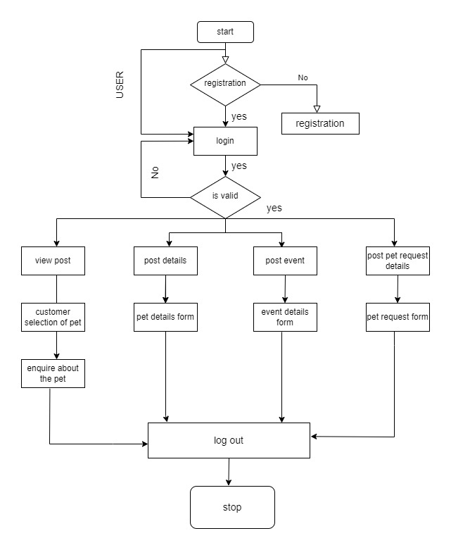
SYSTEM FLOWCHART

Slide 8
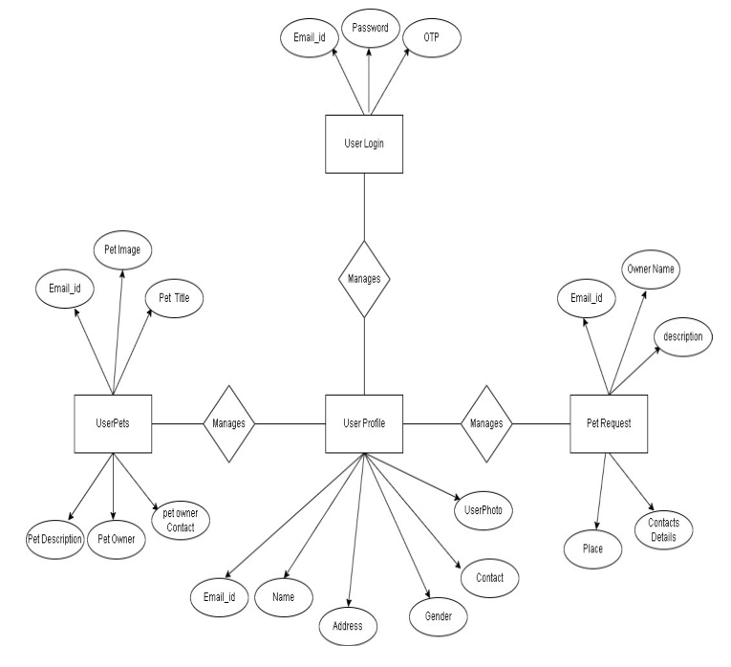
ER DIAGRAM

Slide 9
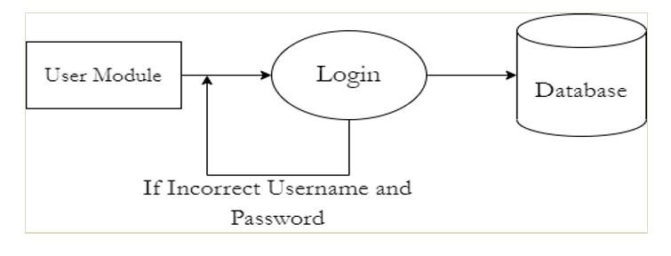
DATA FLOW DIAGRAM

Slide 10
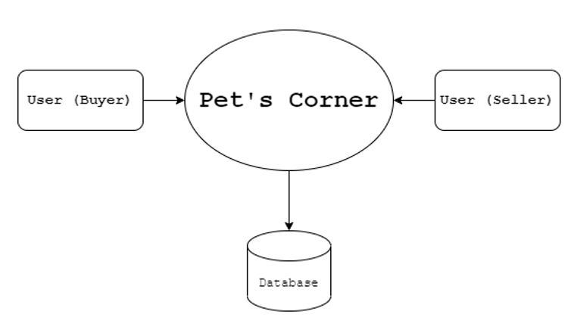
LEVEL 0 DFD

Slide 11
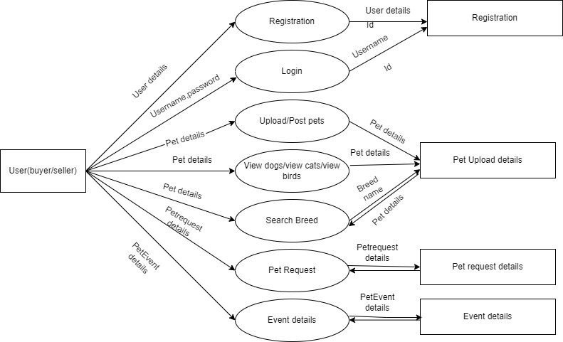
LEVEL 1 DFD

Slide 12
MODULES/IMPLEMENTATION
We have 2 types of users of the system.
USER (Seller):
USER (Buyer) :
Following functionalities can be performed by the user(seller):
Login
Can register his/her account to access the services of pets store application.
Upload pet details
Can update and view other profiles.
Can upload/post pets which are available for sale.
Can response about particular pet to other user request.
Following functionalities can be performed by the user (buyer):
Login
Can register his/her account to access the services of pets store application.
Can upload/post pets which are available for sale.
Can update and view other profiles
Can post request about particular book and get response from other user.

Slide 13
REQUIREMENTS
Hardware Requirements:
Name of Component | Specification
Processor | Pentium core i3 and above.
RAM | 4GB
Hard Disk | 20GB

Slide 14
Software Requirements:
Name of Component | Specification
Operating System | Windows XP and above
Coding language | Java2
Database | WAMP database
Browser | Any of Mozilla, Opera, Chrome etc
Web server | WAMP Server
Software development kit | Android Studio

Slide 15
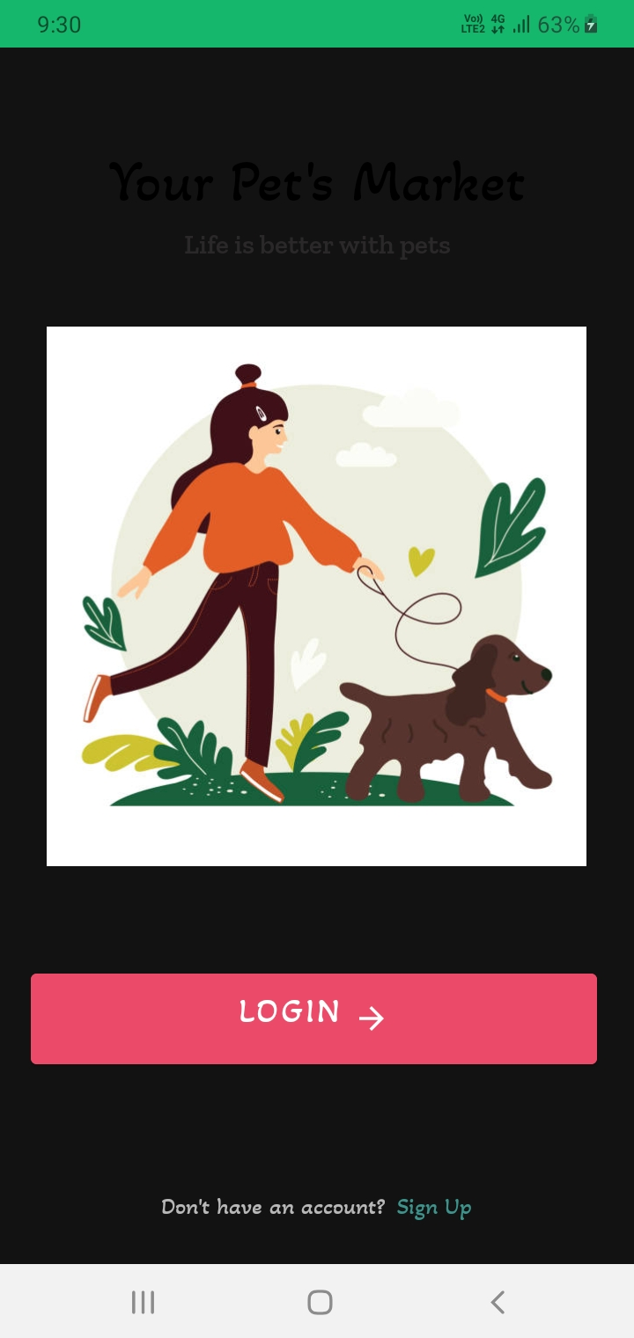
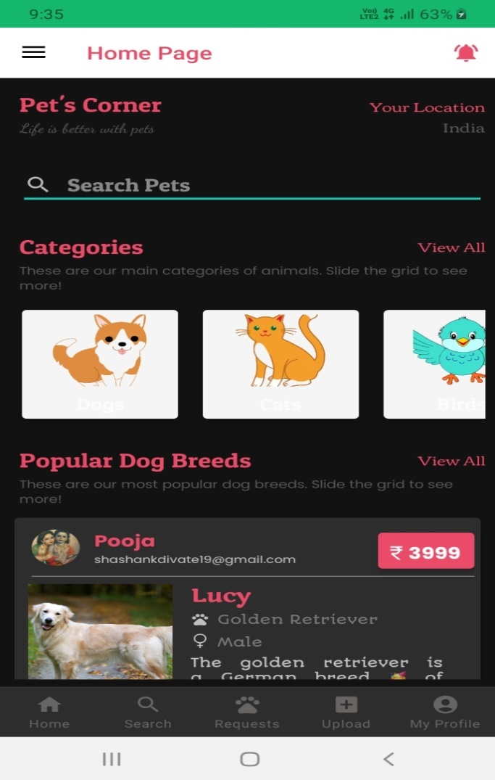
SCREENSHOTS
Login page
Home page

Slide 16
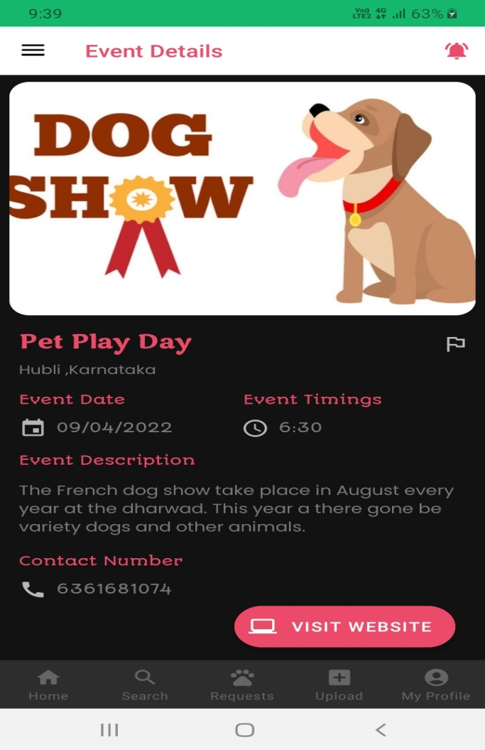
Event Details

Slide 17
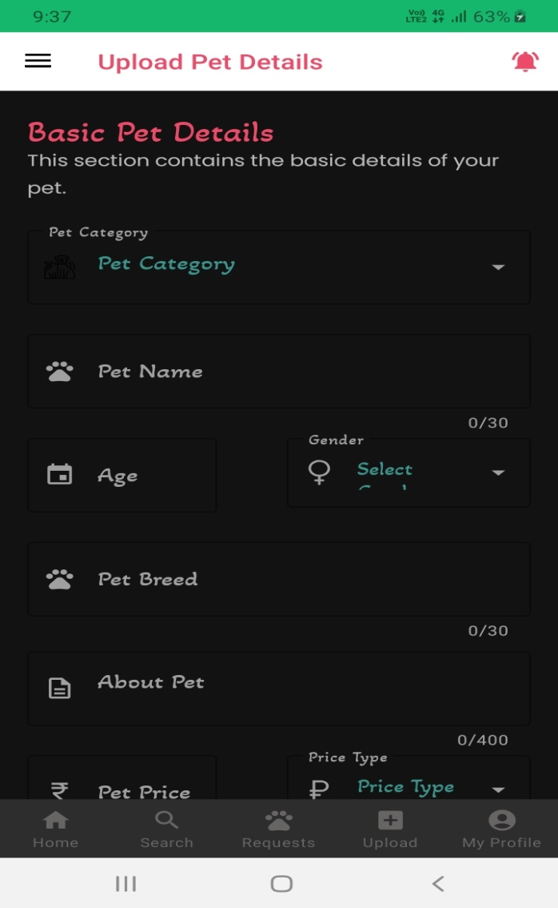
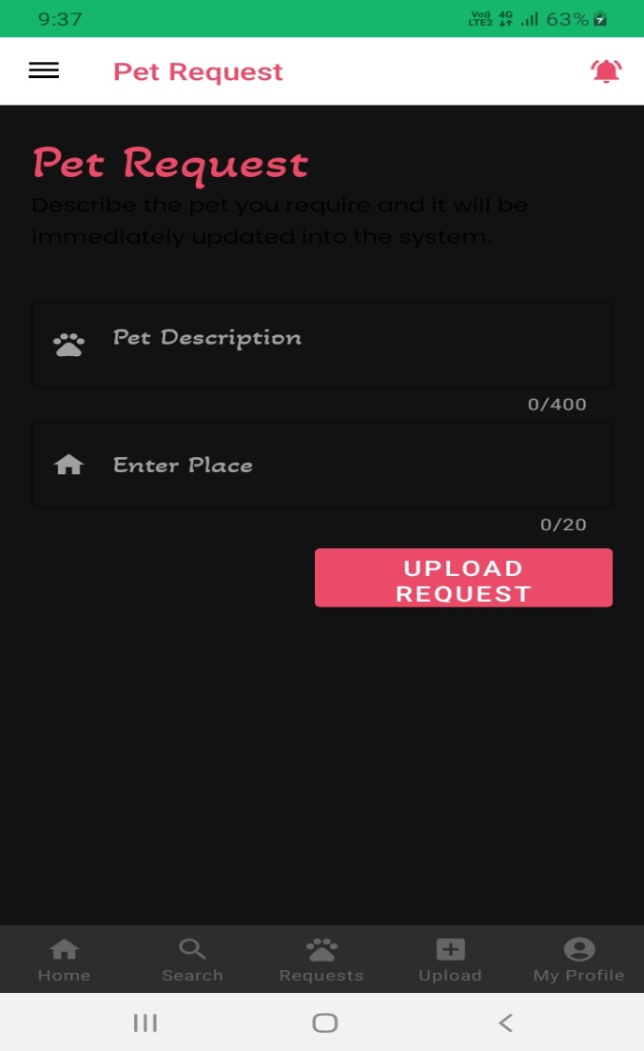
Upload Pet details
Pet Request

Slide 18
CONCLUSION
As part of the project detailed study has been made about the designing and development aspects of the project “Pets corner app using android ” which is an opening to the component world of computerization. We have tried our best to achieve our goals. The project has to meet all the requirements that were collected during analysis and designing phase.
In this project, we will be designing a simple platform for buying and selling pets. Besides these we also provide users with an option to upload/post pet details, events details and they can also do the pet request. The project is developed in such a way that it is able to undergo future enhancement in reliable, secure manner.

Slide 19
LIMITATIONS/FUTURE SCOPE
To include all varieties of breeds.
Home delivery of pet accessories.
An in app chat option between the seller and buyer.
In future Online payment gateways can be implemented.
Multi languages are not supported.

Slide 20
REFERENCES
“Software Engineering”, by lan Somerville, Sixth Edition. Roger – Pressman, Tata McGraw - Hill Education (2009)
Software Engineering: A Practitioner's Approach 7th Edition, Roger – Pressman, Tata McGraw - Hill Education (2010)
Software Engineering, Ian Sommerville, International Computer Science, Series Web Technology: Renuka T Ambigram. Approach 5th Edition (1997)
Fundamentals of Database System: Elmasri & Navathe. Approach 4th Edition (2007)
Websites:
https://w3schools.com for information on HTML.
https://www.tutorialspoint.com/
For Debugging:
https://stackoverflow.com/

Slide 21
THANK YOU

